Slide 1
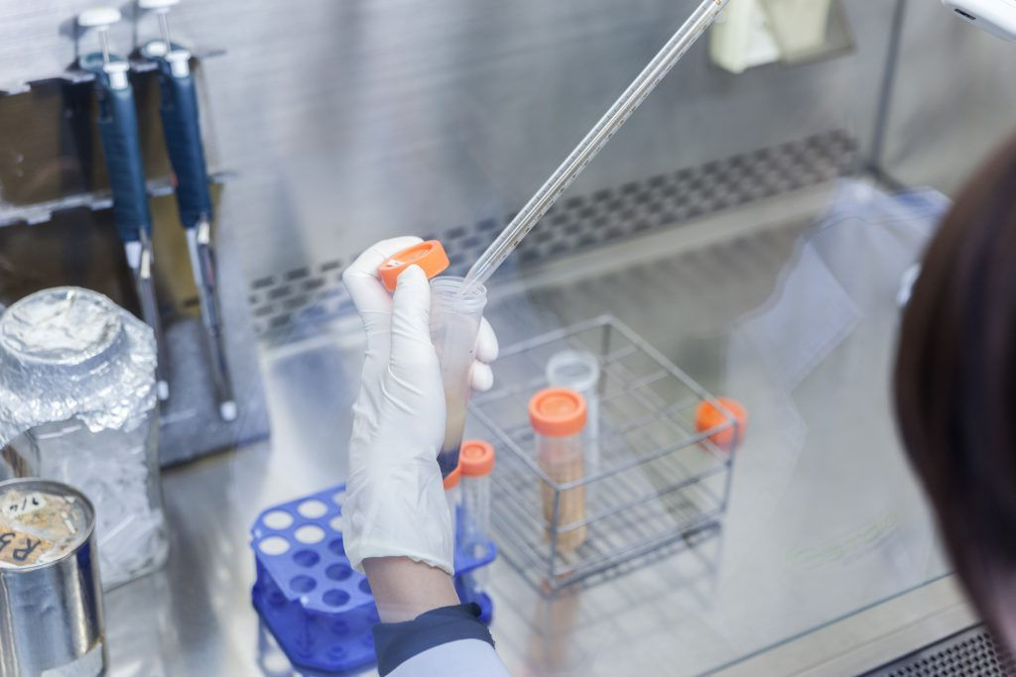
Malaria Parasite Detection from Thin Blood Cell Film Using Convolutional Neural Network
Notes:
NOTE:
To change the image on this slide, select the picture and delete it. Then click the Pictures icon in the placeholder to insert your own image.

Slide 2
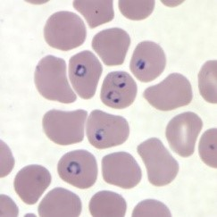
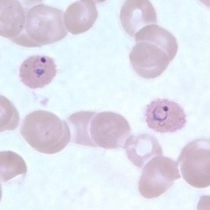
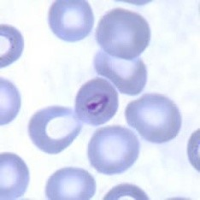
WHAT IS MALARIA?
A life-threatening disease transmitted through the bite of an infected Anopheles mosquito. Infected mosquitoes carry the Plasmodium parasite.
Four kinds of malaria parasites that can infect humans: Plasmodium vivax, P. ovale, P. malariae, and P. falciparum.
P. falciparum causes a more severe form of the disease and those who contract this form of malaria have a higher risk of death.
P. falciparum
P. vivax
P. ovale

Slide 3
MALARIA MICROSCOPY
Current available techniques can be separated in three categories:
Microscopy
Thick and Thin Blood Smear Study
Quantitative Buffy Coat (QBC) Test
Immunological techniques
Molecular techniques
Thick and Thin Blood Smear Study is the most popular or gold standard method for malaria diagnosis.

Slide 4
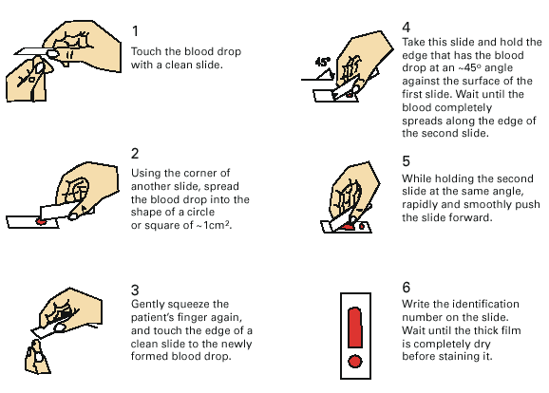
PREPARATION OF A THICK & THIN BLOOD FILM

Slide 5
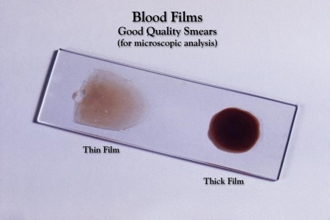
OBSERVATIONS
Normal
No parasites are present in red blood cells. The test will be repeated every 8 hours for 1/2 days if still suspected that you have malaria.
Abnormal
Parasites are present in red blood cells. The infecting species of Plasmodium is identified. Also, the percentage of red blood cells infected by the Plasmodium parasite (density) is determined.

Slide 6
AREA OF DEVELOPMENT
Multi-class classification of Malaria parasites (Plasmodiam vivax, P. falciparum, P. ovale, P. knowlesi etc.) developed in blood cell.
Automation of whole diagnosis process and diagonose from thick blood film
Segmentation of infected area.

Slide 7
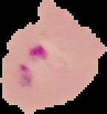



DATASET
Dataset was taken from NIH (National Institution of Health) public repository.
The dataset consists of 27,580 images where 13,784 images are for Uninfected and 13,796 images are for Parasitized.
To avoid undertrained condition we take more percentage dataset for training. But primarily, in case of 10% validation, it shows some undertrained conditions where training accuracy was less than validation accuracy.

Slide 8
PIPELINE
Pre-Processing and Augmentation
Main purpose of pre-processing is to avoid over-fitting of the model. List of augmentation used before training are:
Augmentation Type | Parameters
Image Size | 112*112
Random Horizontal Flip
Random Rotation | 90 degrees
Random Colour Jitter | Contrast 150%

Slide 9
PIPELINE
Model Selection
Lots of model available to train this binary classifier. Different models have different architectures. Thus they can extract different features from an image. Our used model are : Resnet 152 ,Resnet 101, Resnet 50, Densenet 161, Resnext 50.
Training
Machine learning works by finding a relationship between a label and its features. We do this by showing an object (our model) a bunch of examples from our dataset. Each example helps define how each feature affects the label. We refer to this process as training our model. Every epoch of training means new set of weight. New weight gives new opportunities.

Slide 10
MODEL PERFORMANCE
Comparison of several models after tweaking hyper-parameter are given below:
TABLE I
SCORES OF DIFFERENT NETWORK MODELS ON VALIDATION SET
Model | Accuracy | Loss
ResNet-101 | 91.677 | 0.3750
ResNet-50 | 88.69 | 0.4104
ResNeXt-50 | 94.55 | 0.1630
ResNet-152 | 96.03 | 0.1112
DenseNet-161 | 96.26 | 0.1138

Slide 11
SIGNAL PROCESSING
Image is a 2D signal. By forward-propagation and back-propagation model it’s weight can be updated.
In deep learning, many hidden layers are used. Among them convolutional layer is the major building block used in convolutional neural networks.. Here 2D convolution takes place.
The image size is also enhanced which is actually up-sampling and done by interpolating pixels in the image. Conversely, reducing image size does down-sampling by cancelling some pixels in the image.

Slide 12
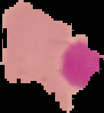
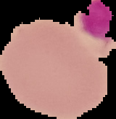
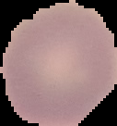
LABEL NOISE
Label noise refers to error in labelling. Suppose a uninfected image was suppose to labelled as uninfected which can easily be detected by pathologist but it may be labelled as Parasitized. Some example found from validation, training, testing dataset is given below:
Labelled as Uninfected
Labelled as Parasitized

Slide 13
OUTPUT ANALYSIS
96 images were tested.
TABLE II
SCORES OF DIFFERENT NETWORK MODELS ON TEST SET
Model | Accuracy | Precision | Sensitivity | Specificity | F1
DenseNet-161 | 97.916 | 96.97 | 96.97 | 98.41 | 96.97
ResNet-50 | 94.791 | 96.67 | 87.878 | 98.412 | 92.064
ResNet-101 | 90.625 | 83.33 | 90.91 | 90.476 | 86.96
ResNet-152 | 92.70 | 90.625 | 87.88 | 95.23 | 89.23
ResNeXt-50 | 97.916 | 94.285 | 100.0 | 96.82 | 97.059

Slide 14
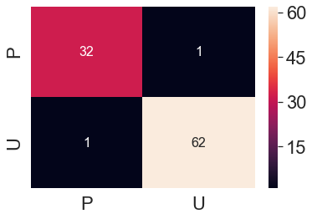
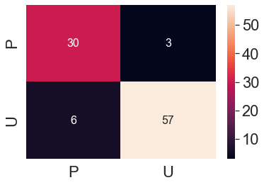
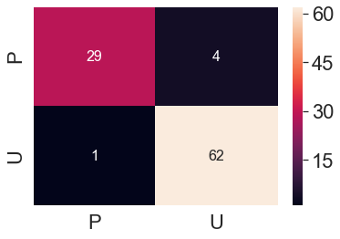
CONFUSION MATRIX
Densenet161
ResNet152
ResNext
ResNet101
ResNet50

Slide 15
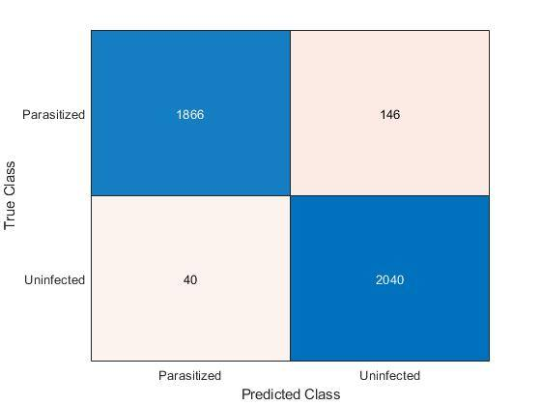
ACCEPTABILITY OF THE TEST
Sensitivity is defined as the ability of a test to identify as positive (all the patients who actually have the disease.)
Specificity is defined as the ability of a test to identify as negative (all the patients who do not have the disease.)
That's why we have to choose between them and conclude that trained model is best for the test.
Confusion Matrix of ResNeXt model using MATLAB

Slide 16
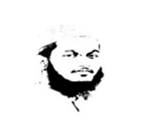

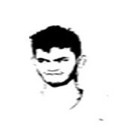
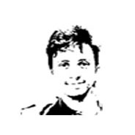
EEE 312
THE TEAM
Zulqarnain Bin Ashraf
ID. 1606153
Md. Abrar Istiak
ID. 1606155
Mortuza Minhaj Chowdhury
ID. 1606157
Md. Taufiqur Rahman Shuvo
ID. 1606159

